Slide 1


Imcgd214-Managing games production Imcgd111-Group project L4/5 GROUP 2
Jordan Marks
Alice Baker
Thomas Gibbs
Daniel Pokladek

Slide 2
The brief
Physics based game
Easy to learn game yet hard to master
Adversarial Gameplay.
Symmetrical gameplay.
J

Slide 3
Logline and target audience
Logline – Beat your Foes in this gravity based planetary arena.
Target audience – 18-35 Male and Female
Platform – Mobile
J

Slide 4
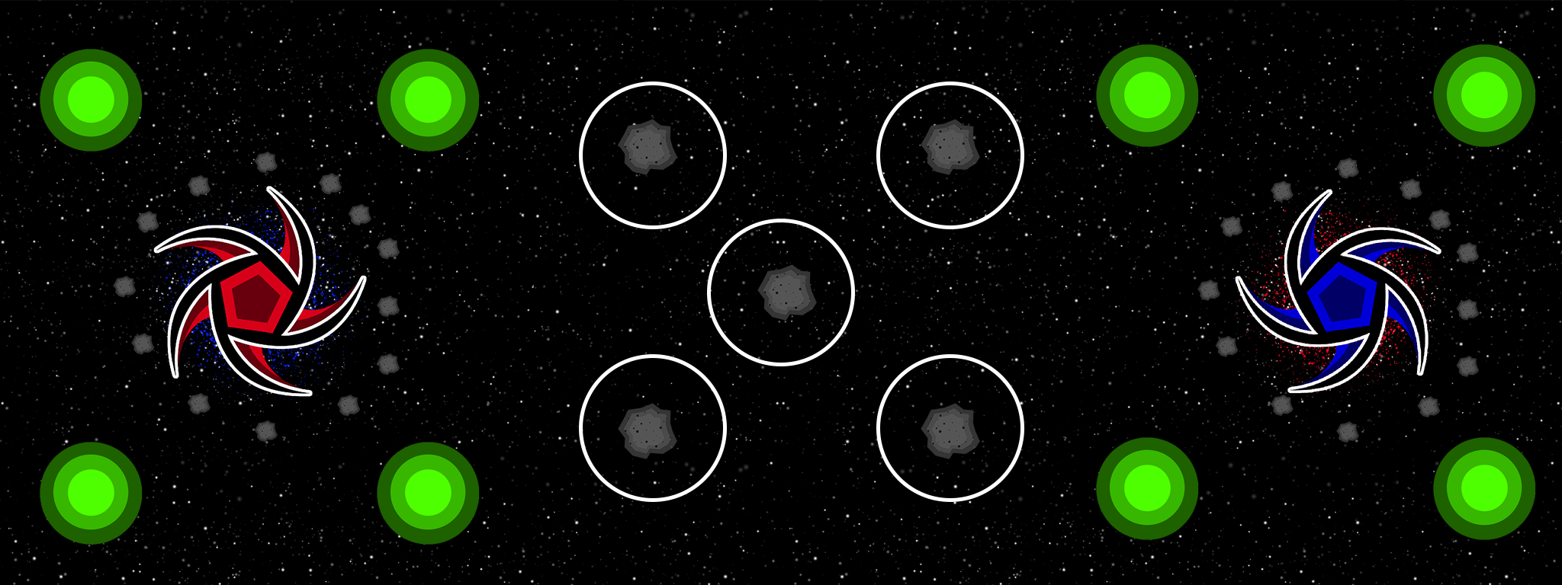
Game
What the player does
Physics in the game
Turn based game play
TD

Slide 5
Prototype
TD

Slide 6
how the game meets the brief
Two player –
Adversarial Gameplay.
Symmetrical gameplay.
Physics -
Gravity wells.
TD

Slide 7
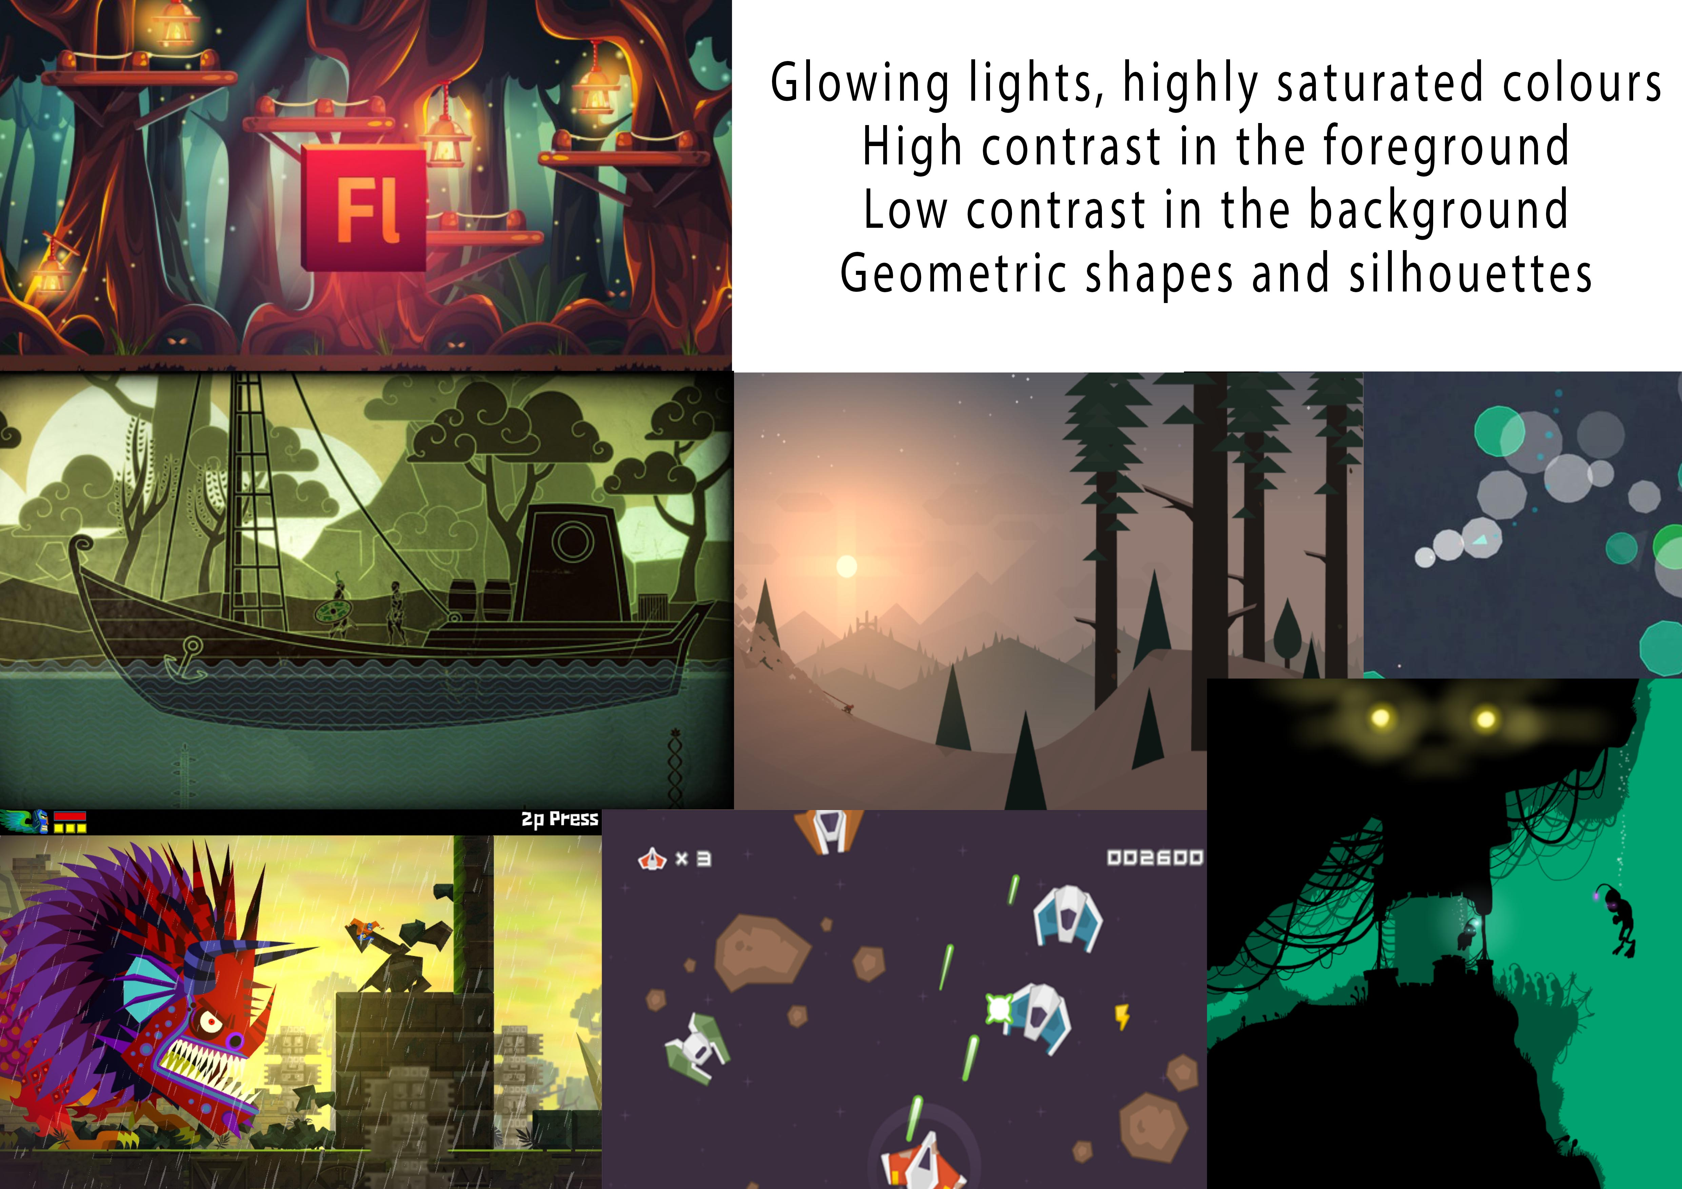



Art style and Moodboard
A

Slide 8
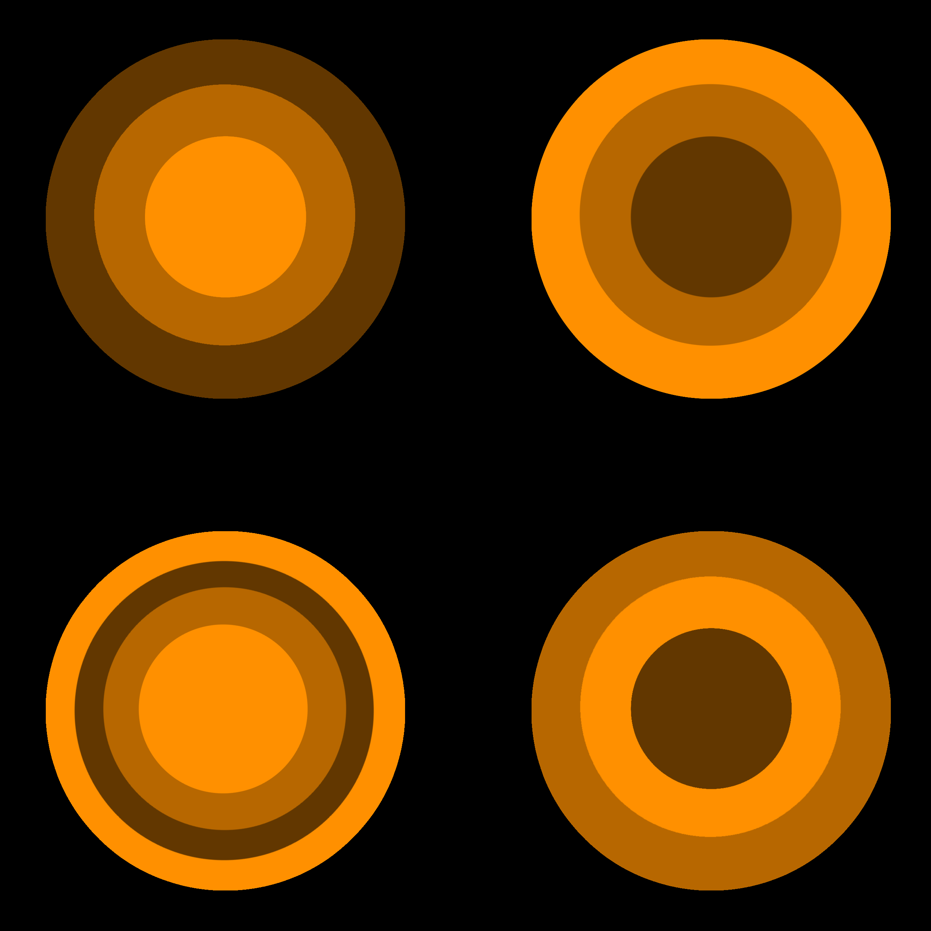
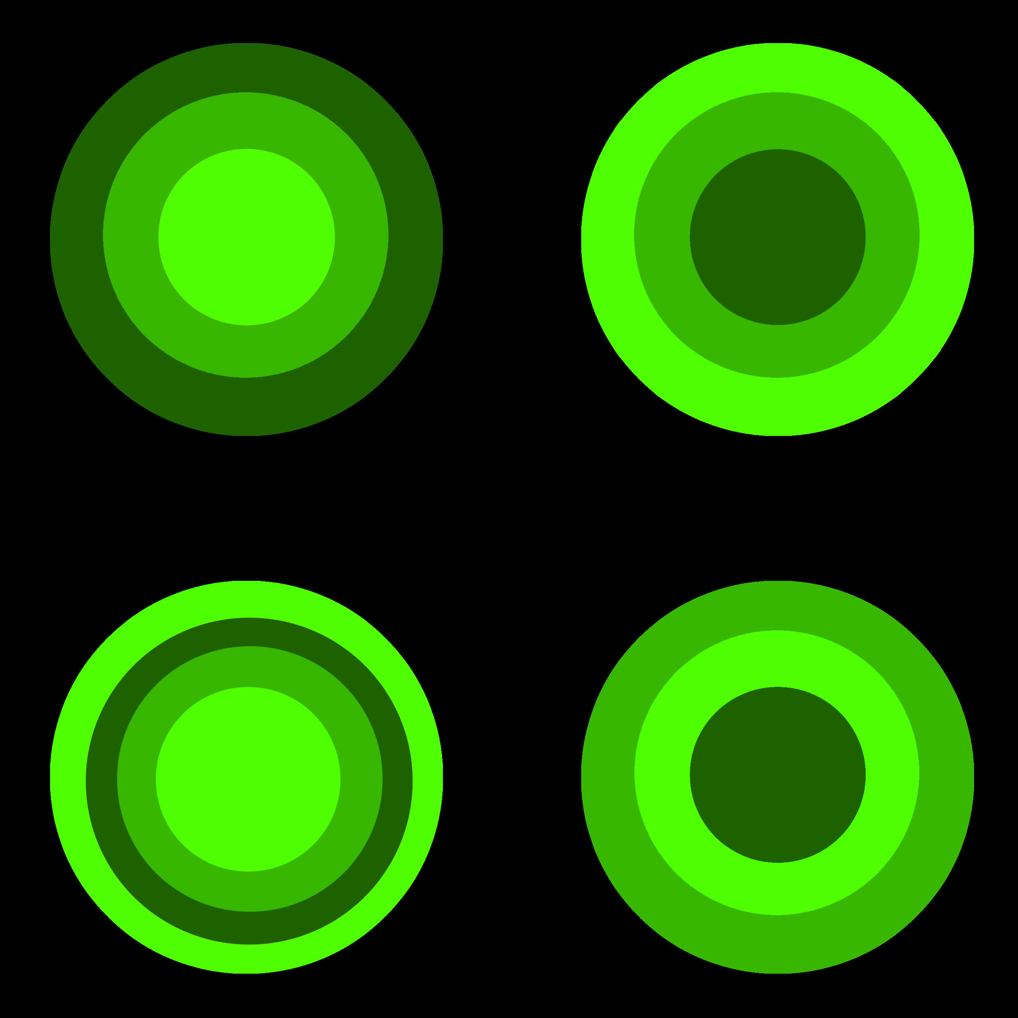
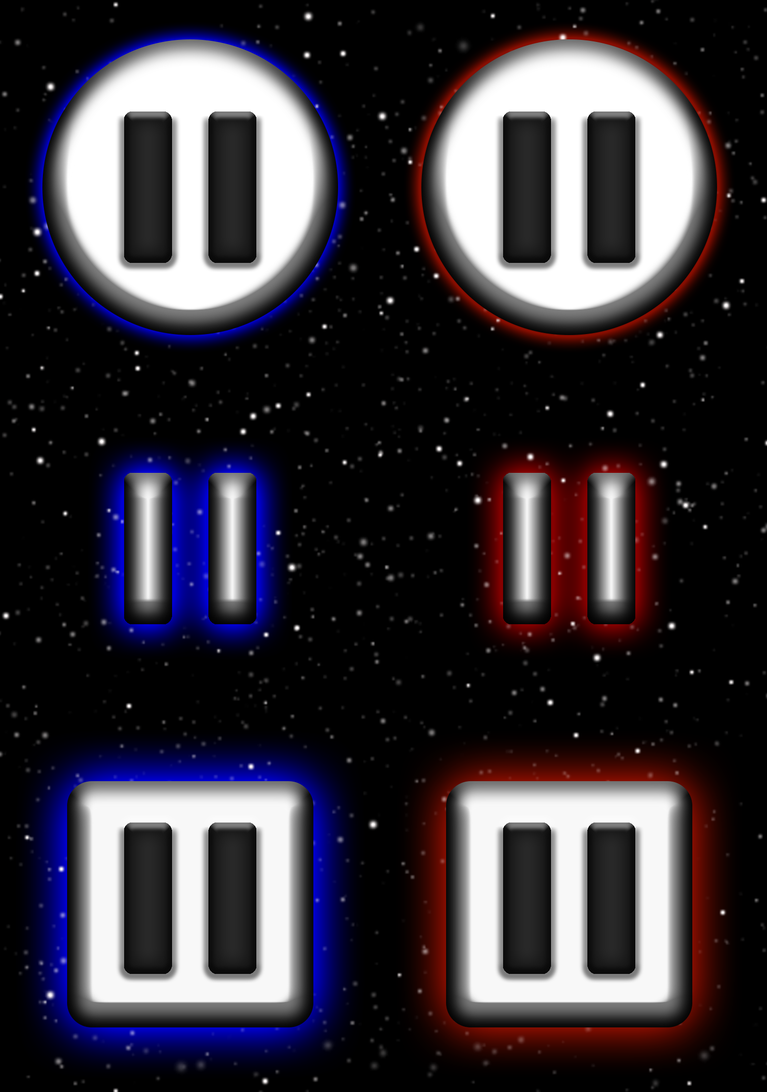
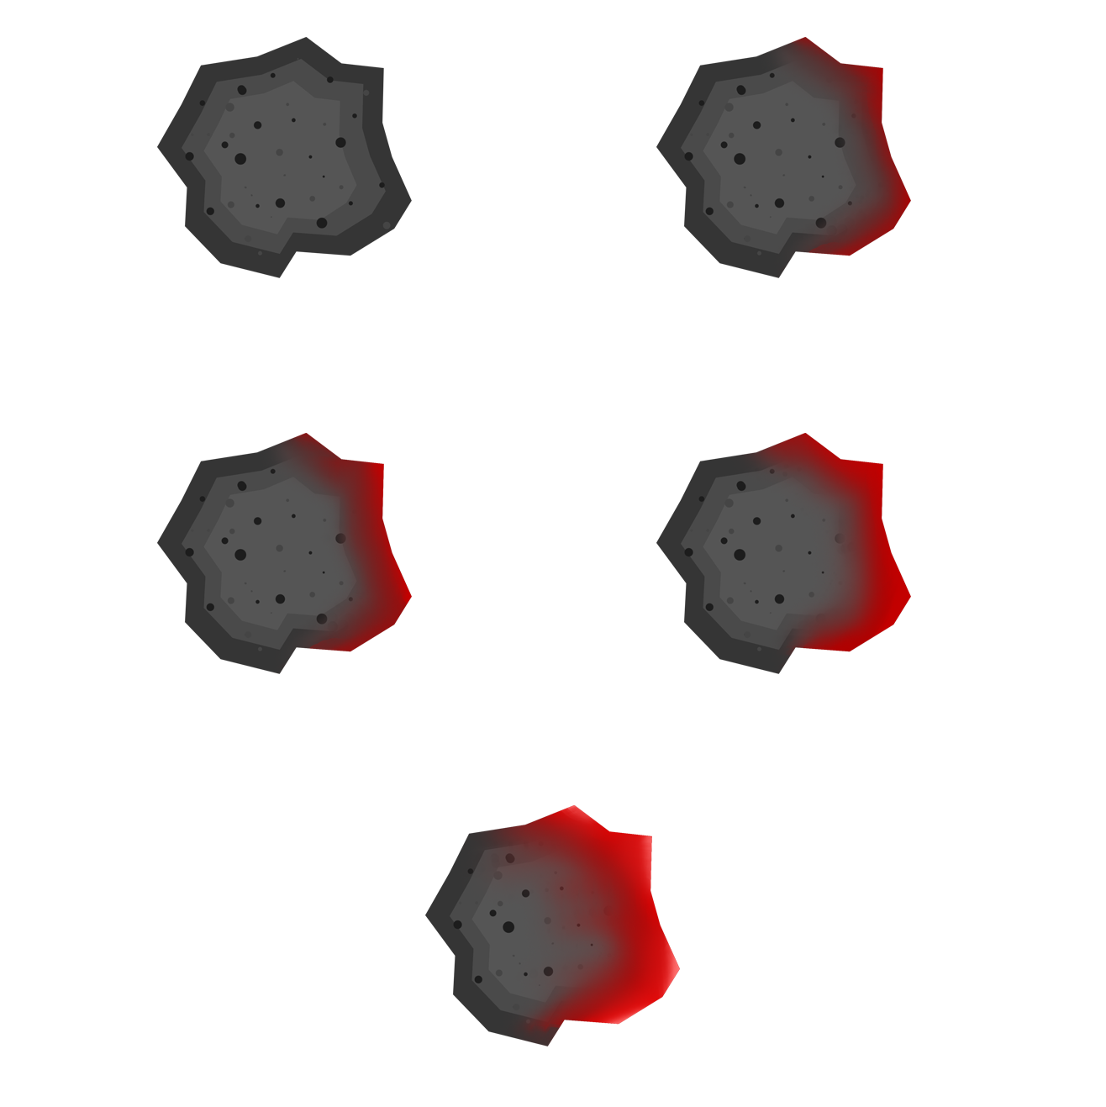









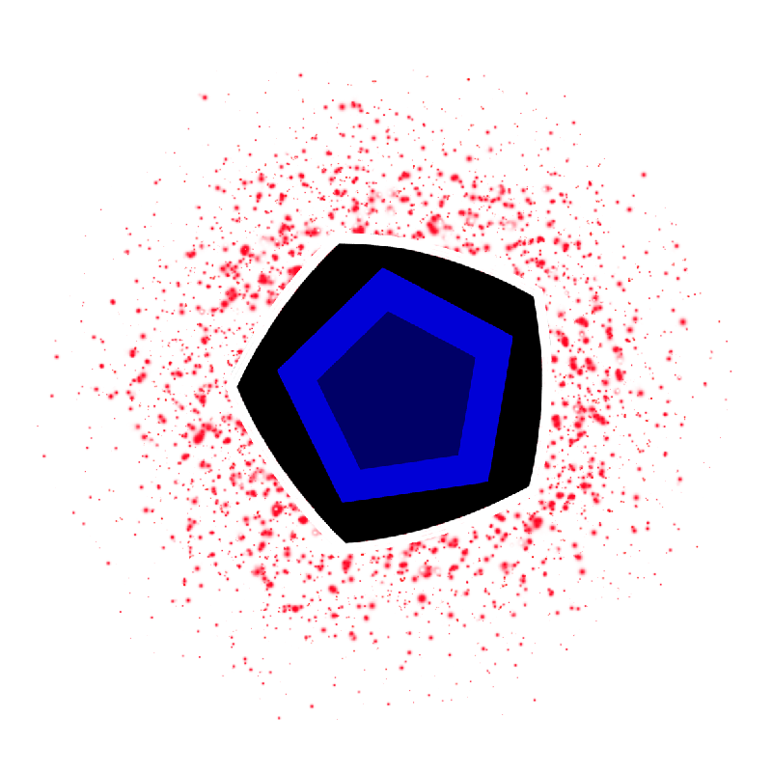
Game art
A

Slide 9
What we will deliver at the end of the project?
Fully playable Prototype of the game
Game have been Playtested by the most players we can.

Slide 10
What we have left to do to achieve this?
Playtesting
Finalize the Art
Finalize The Code.

Slide 11
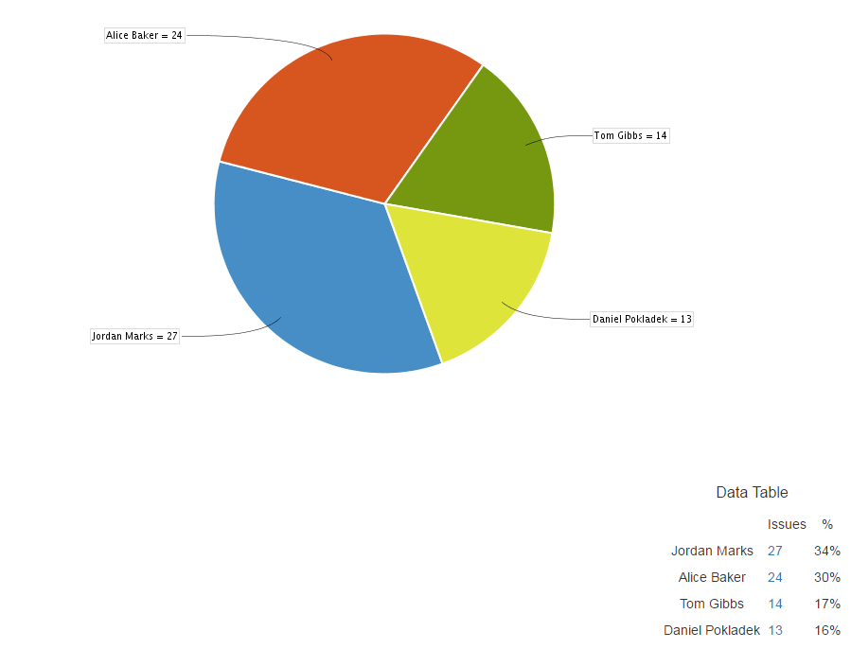
management
Emails (For the last for 4 weeks)
Jordan - 12
Alice - 7
Dan - 5
Tom - 4
Hours (For the last for 4 weeks)
Jordan -
Alice -
Dan -
Tom -
Tasks by person (For all weeks of the project.)

Slide 12
Questions?

